Slide 1

Image And Video Colorization Using Deep Learning

Slide 2
Problem Statement
To Convert a black and white image or video into a colored image or video using deep learning
Challenges:
Complicated model, difficult in interpretation.
Difficult to train model with limited resources.
Making results interpretable.

Slide 3
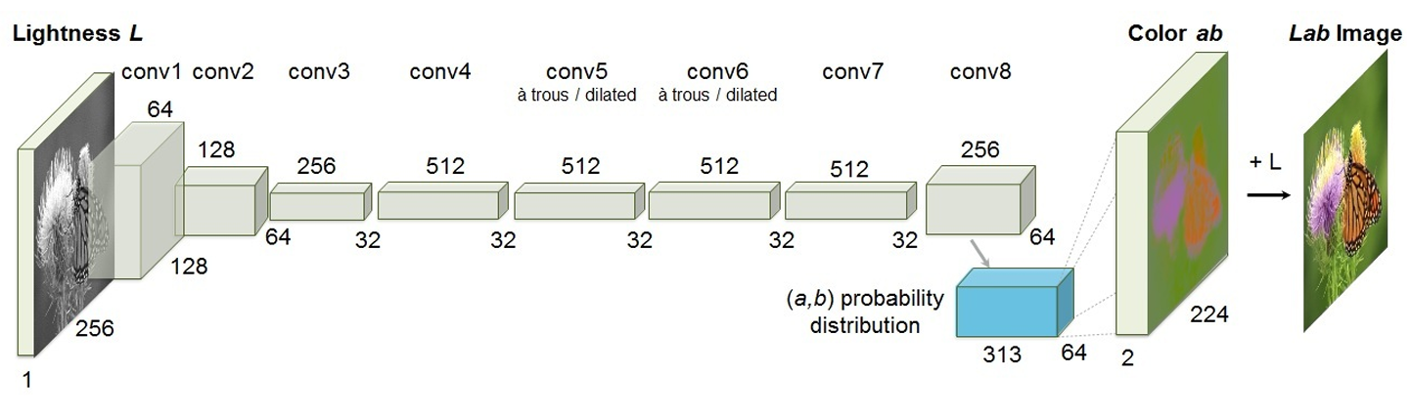
Network Architecture
The first 5 stages use 3x3 kernels, stride 1, padding 1. Small kernels stacked deepen the network and keep parameters managable.
The pools are 2x2, stride 2. Pooling halves spatial dimensions.
The later stages are used for context aggregation by Dilated Convolutions instead of pooling(which kills the resolution).
Dilation inserts holes, a dilation d=2 filters 1 pixel apart, so effective size becomes 5x5.
The final layer turns features into a per-pixel class score over k=313 channels.
The softmax is applied across the 313 channels to yield probabilities.

Slide 4
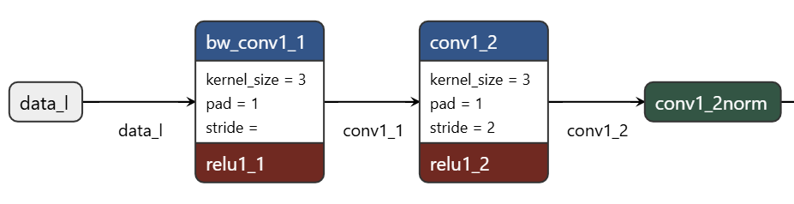
Network Architecture
256x256 grayscale image with L channel.
Batch Normalization.

Slide 5
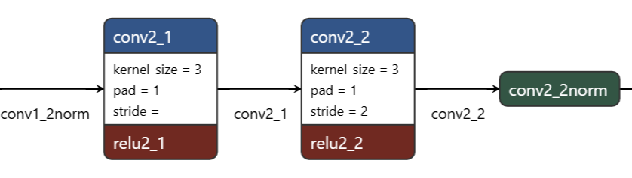
Network Architecture
Batch Normalization.

Slide 6
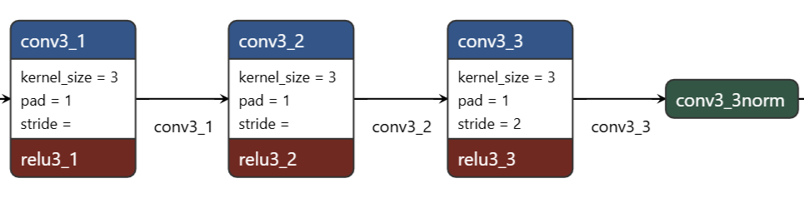
Network Architecture
Batch Normalization.

Slide 7
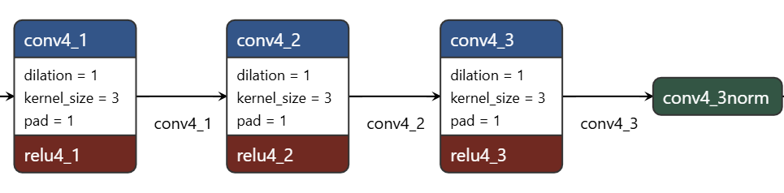
Network Architecture
Batch Normalization.

Slide 8

Network Architecture
Batch Normalization.

Slide 9
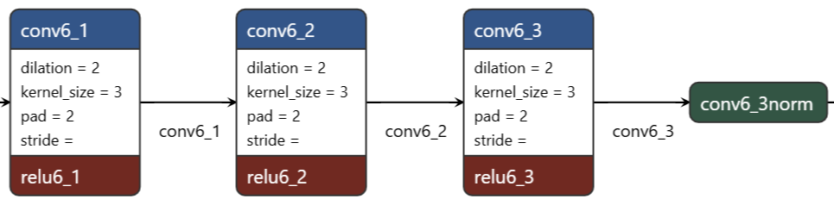
Network Architecture
Batch Normalization.

Slide 10
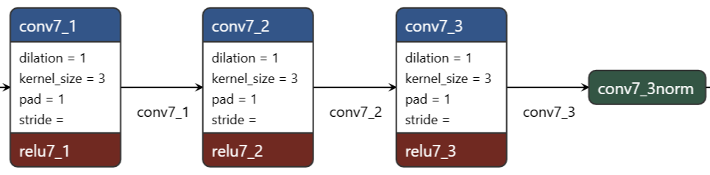
Network Architecture
Batch Normalization.

Slide 11
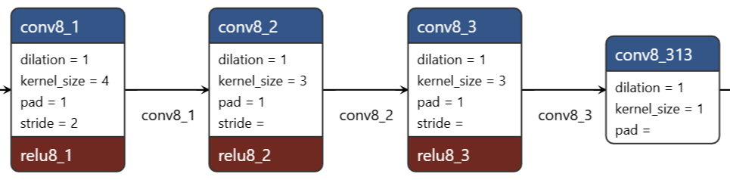
Network Architecture

Slide 12
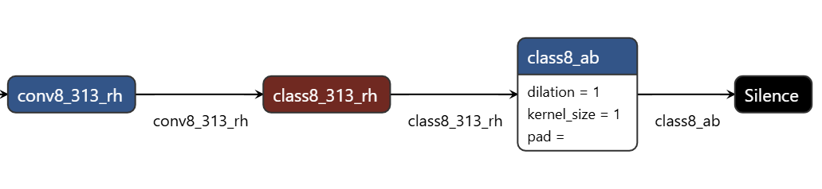
Network Architecture
The ab space is part of lab color space.
a: The axis that turns from green to red
b: The axis that turns from blue to yellow.
The conv8_313_rh layer turns features into a per-pixel class score over k=313 channels.
The softmax is applied across the 313 channels to yield probabilities.

Slide 13
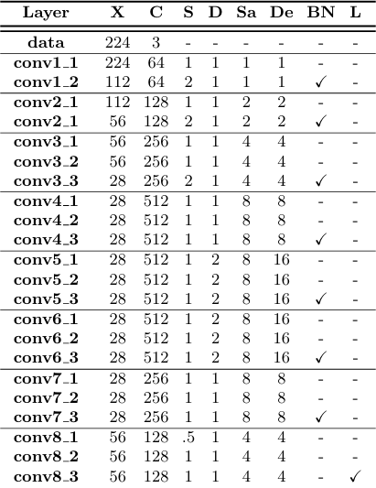
Network Architecture
X: spatial resolution of output,
C: number of channels of output,
S: computation stride,
D: kernel dilation,
BN: whether BatchNorm layer was used after layer,
L: whether a 1x1 conv and cross-entropy loss layer was imposed

Slide 14
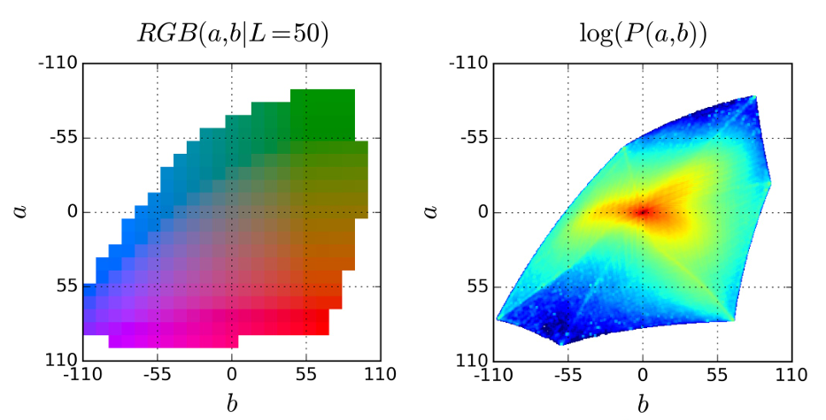
ab color space for a given L
This shows the range of colors the model can produce in LAB space for a given lightness(L).
This plot shows the natural frequency of colors in real world images.
Quantized ab color space with a grid size of 10. A total of 313 ab pairs are in gamut.
Empirical probability distribution of ab values in log scale.
a: The axis that turns from green to red
b: The axis that turns from blue to yellow.

Slide 15
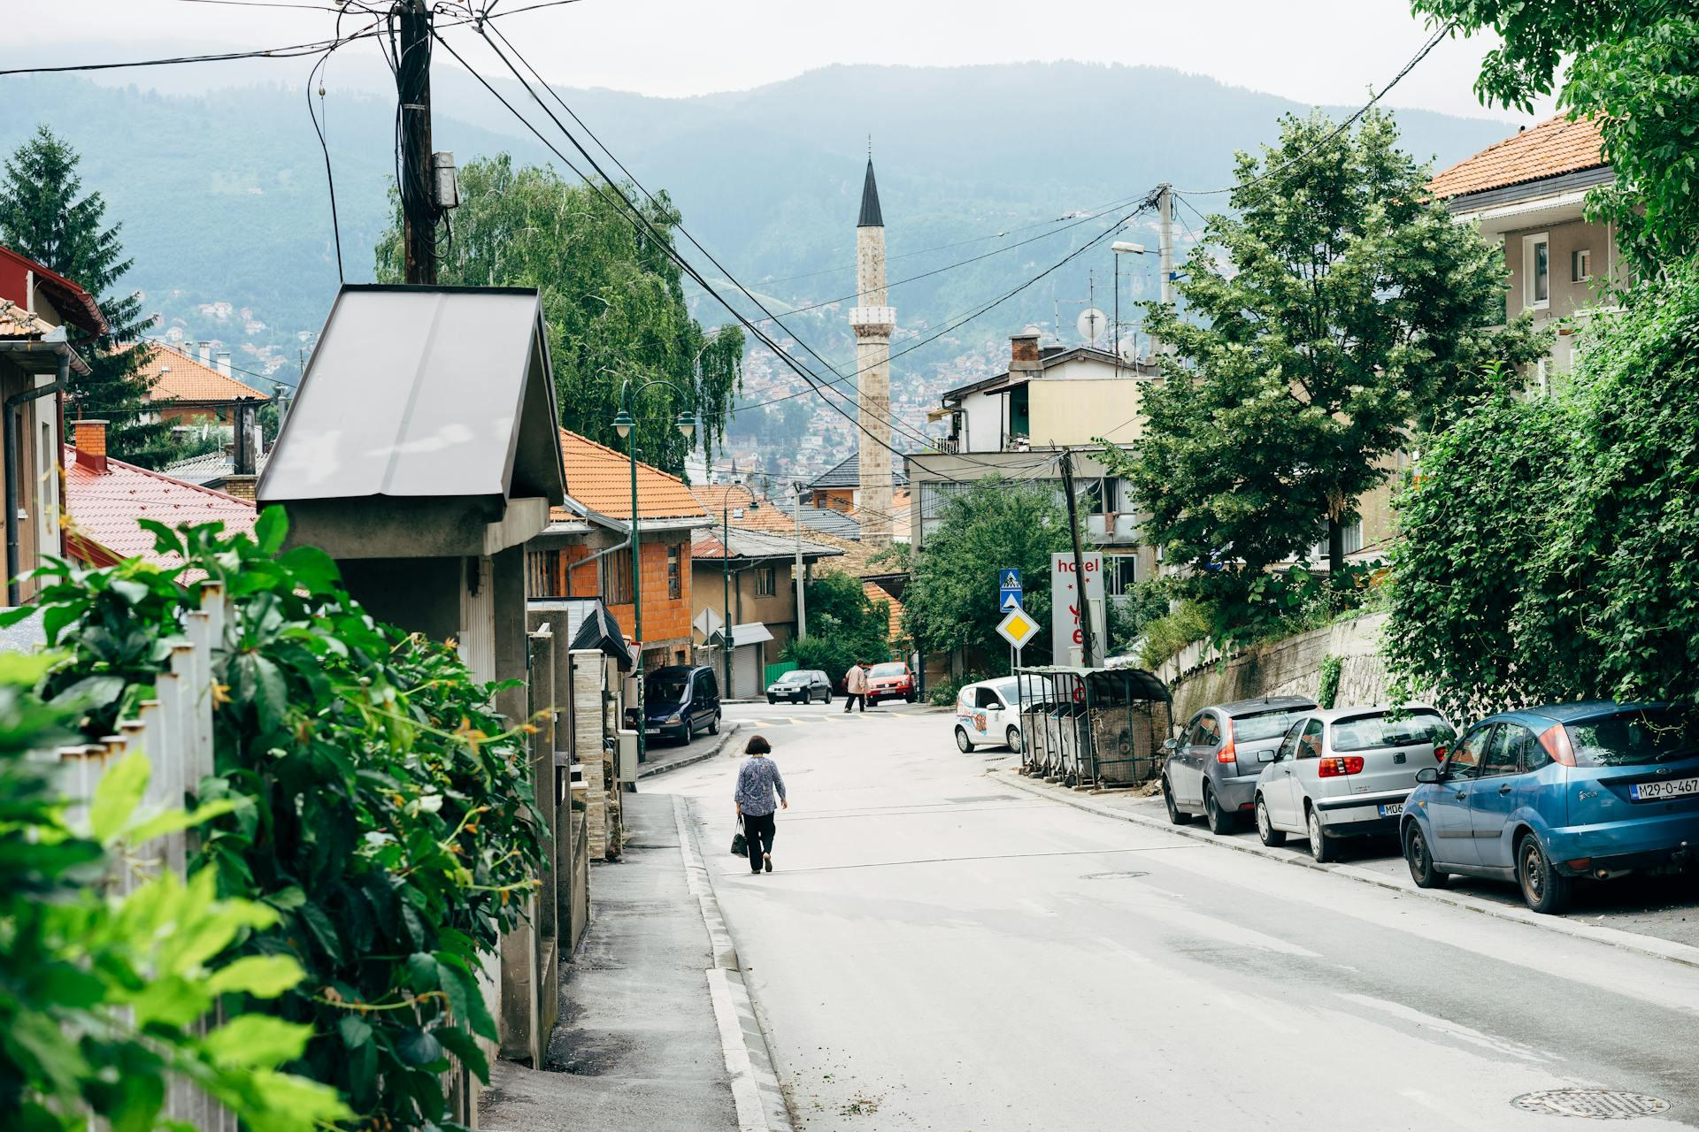
Results
Original Image

Slide 16
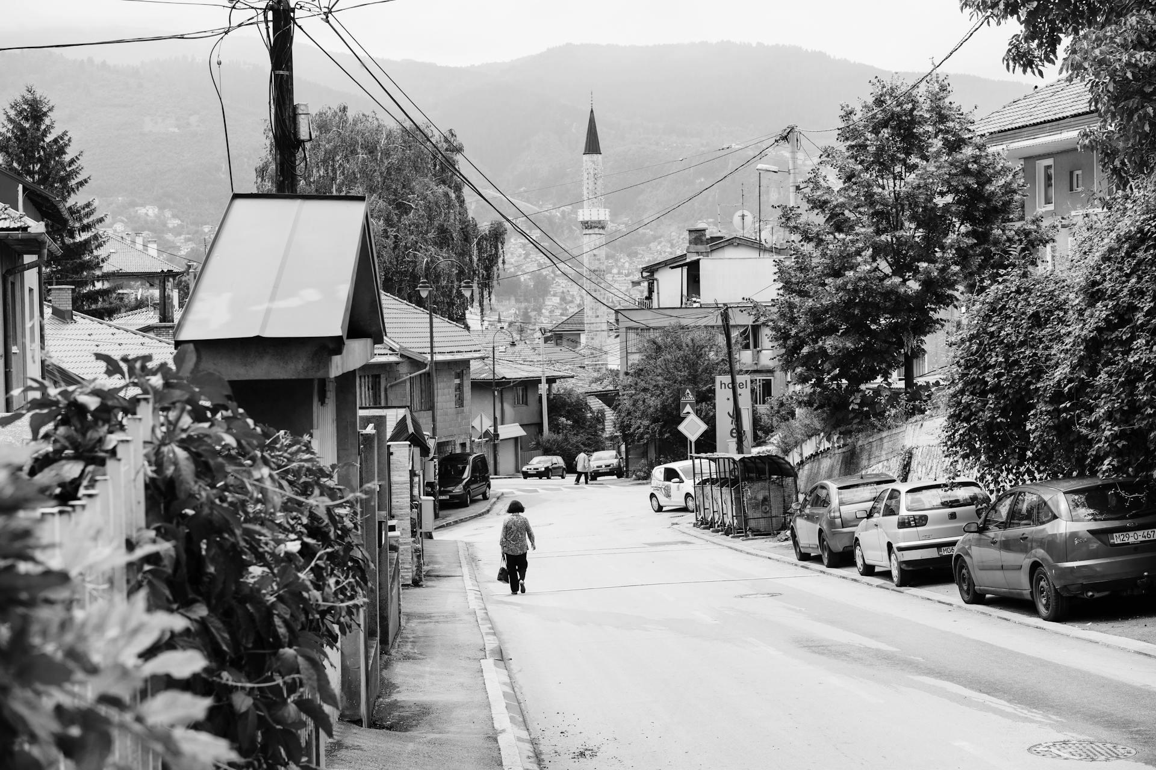
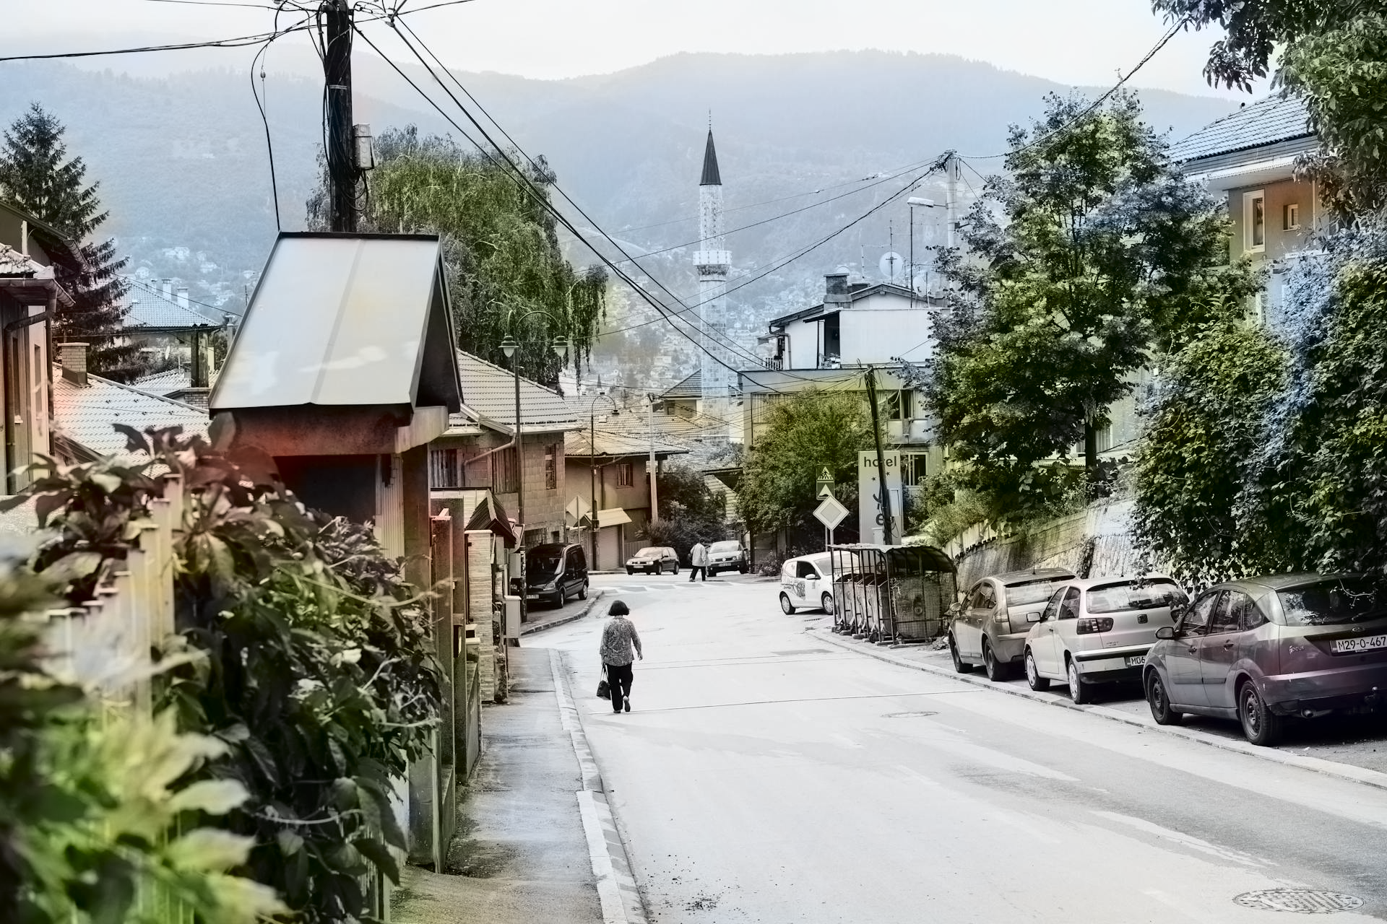
Results
Black and White Input Image
Colored Predicted Image

